Slide 1
Introduction to BootStrap
Sandeep G

Slide 2
Who Am I?
Engineer / Front End developer
Worked in Software AG, MSFT, SAP
~9 years of experience
Worked in React JS, TypeScript, JS, CSS, HTML

Slide 3

Agenda
What is a UI library ?
What is Bootstrap ?
Why Bootstrap is useful ?
Getting started with bootstrap
Bootstrap’s Grid System
Components in Bootstrap

Slide 4
Introduction

Slide 5
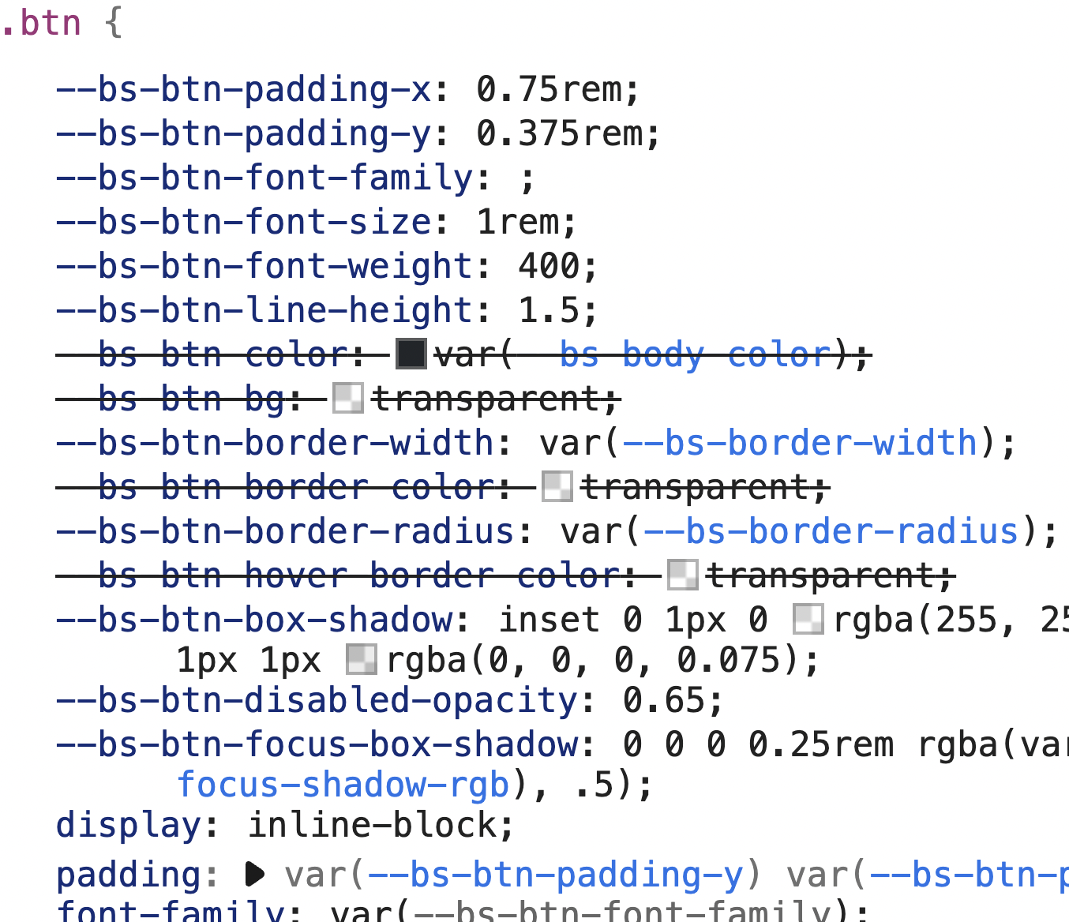
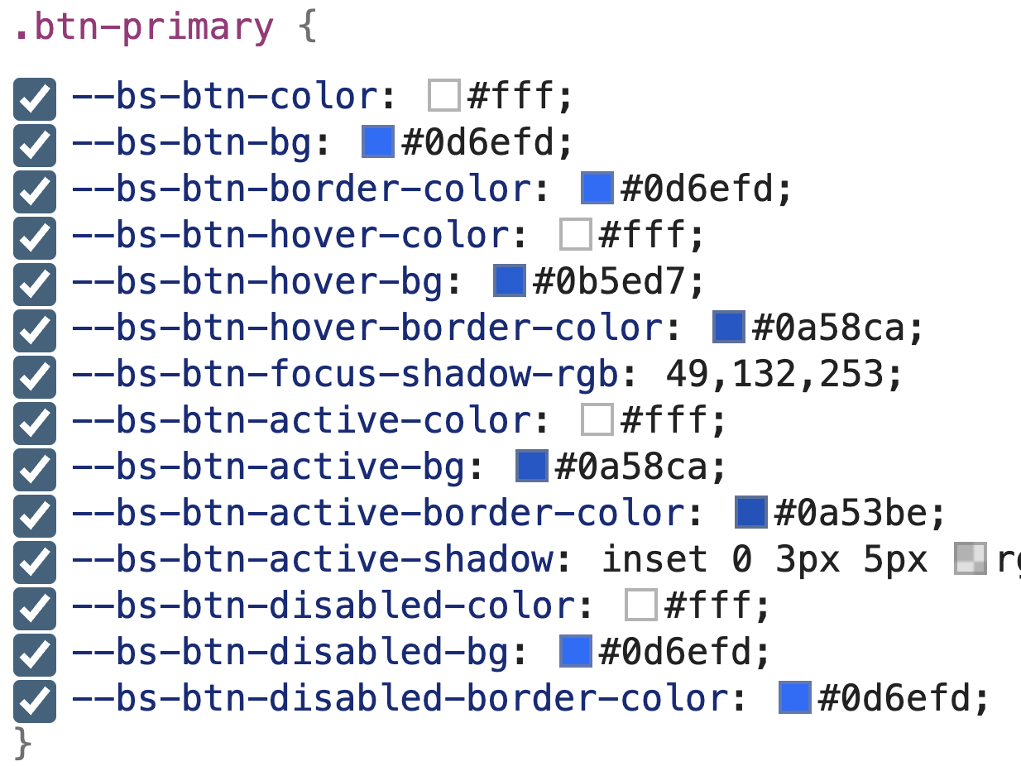
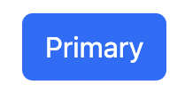
What are CSS Framework?
It is a library which provides ready-made UI components, such as button, input, dialogs, etc.
Biggest perks of these being - the UI components are mobile compatible.
Easy to use - easy to customize.
Some of the popular CSS Framework - Bootstrap, Tailwind, Foundation, etc.

Slide 6


What is BootStrap?
https://getbootstrap.com/docs/5.3/getting-started/introduction/
CSS framework designed to come up with mobile-friendly, responsive front-end web development.
Useful in -
Developers no longer need to code from scratch.
Helps to create responsive/mobile friendly web page.
We may have uniformity in our website.
Cross browser compatibility.
Easy to customize.
Target wide range of device -

Slide 7
Getting started
Using CDN -
Add the CSS CDN link, in the <header>
Add the JS CDN link in the <body>
Downloading form the official source -
You may download the bootstrap.min.css and bootstrap.bundle.min.js from the bootstrap download page.
Once done, you may add in the <header> and <body> respectively.

Slide 8
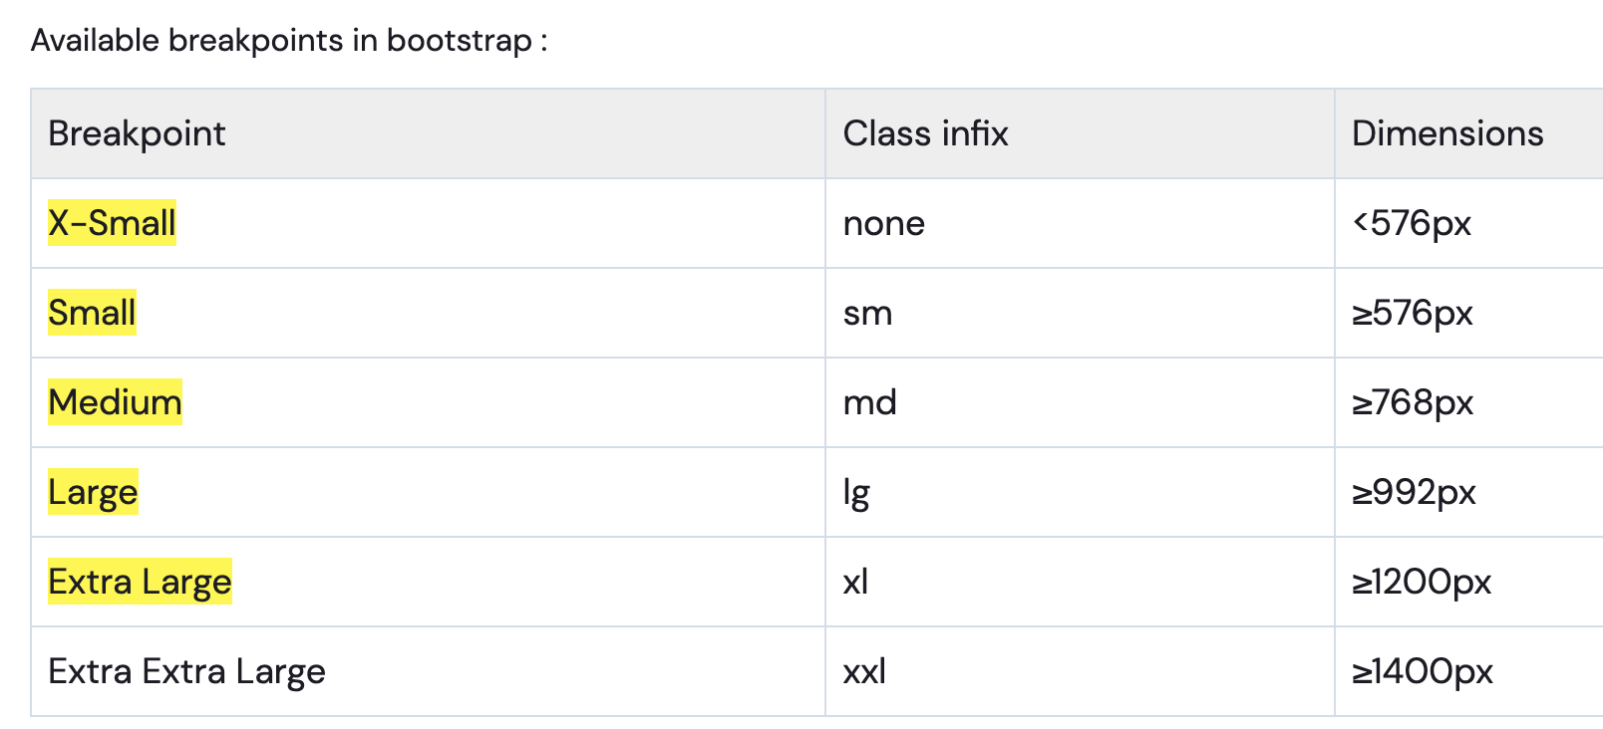
Breakpoints in bootstrap
Breakpoints are the building block of responsive design.
It decides, when your layout will can be adapted at a particular viewport or device size.
They internally use css media queries, to apply different css for different screen sizes.

Slide 9
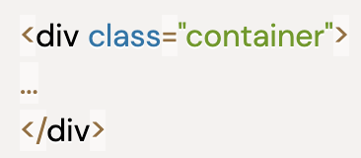

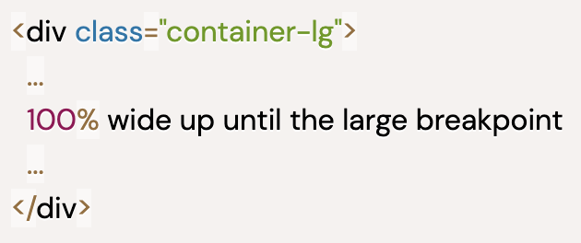
Containers in Bootstrap
A wrapper component which will contain other elements and its grid system.
There are 2 major types of components -
Container - fixed width container, which will change when it faces A breakpoint.
Responsive-containers - This helps in controlling the container Width when in different screen sizes.
Mobile
Tablet
HD Screens

Slide 10
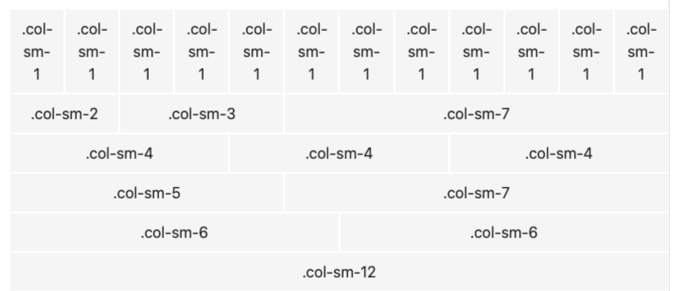
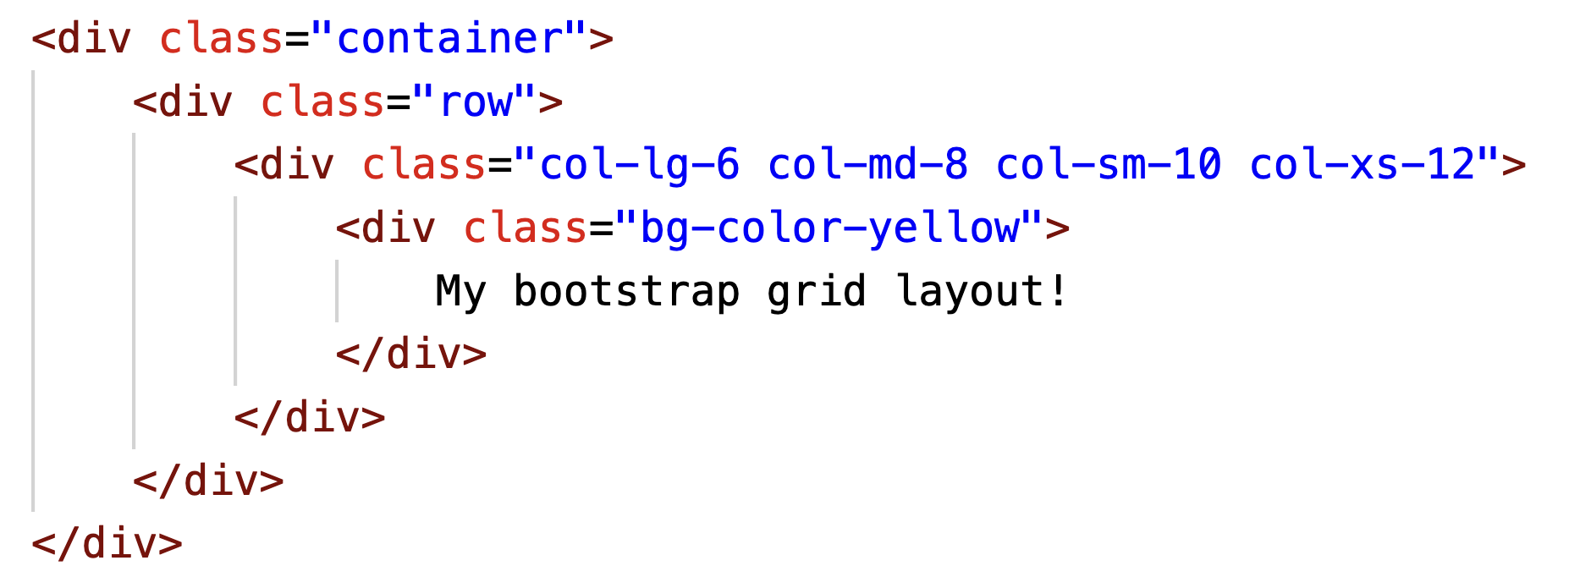
Bootstrap Grid system
It enables you to create advance layouts using rows and columns
The layout can have upto 12 columns.
There are various predefined grid layout classes which would help you to make grids in no time.
The class hierarchy should be like this -
.container > .row > .col-lg-12

Slide 11
Bootstrap Components

Slide 12
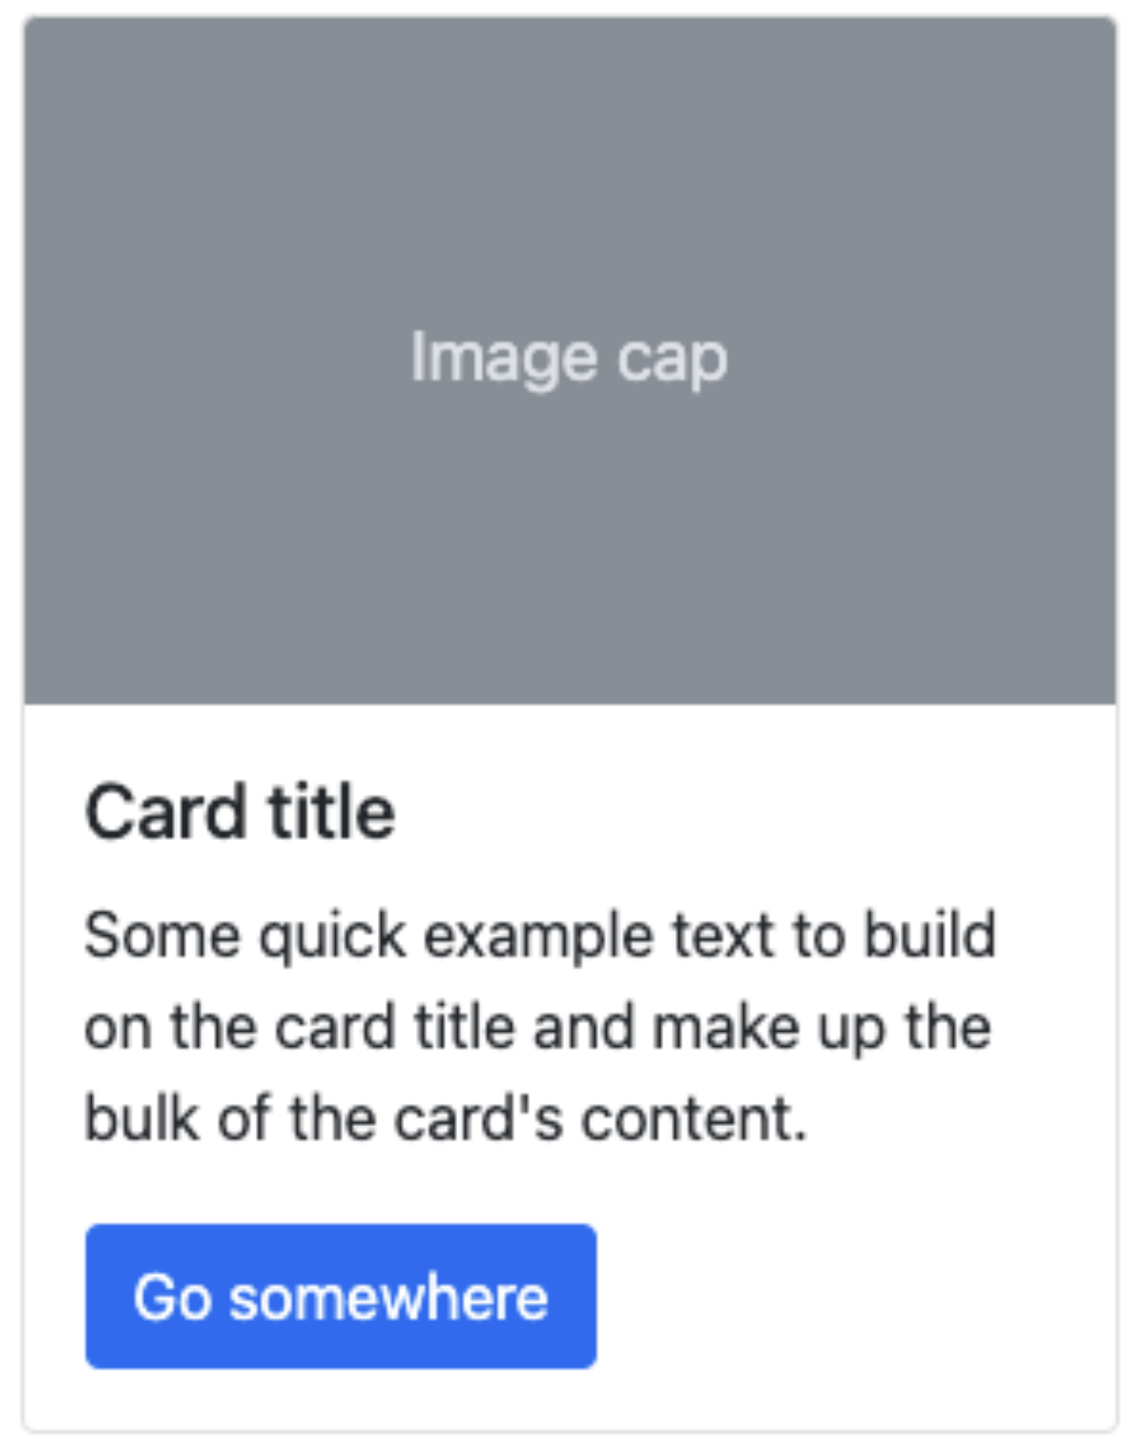
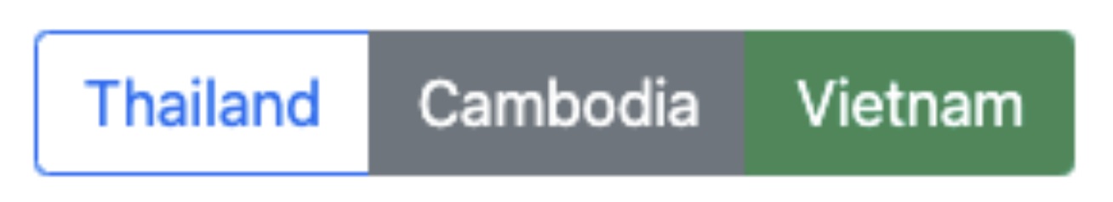
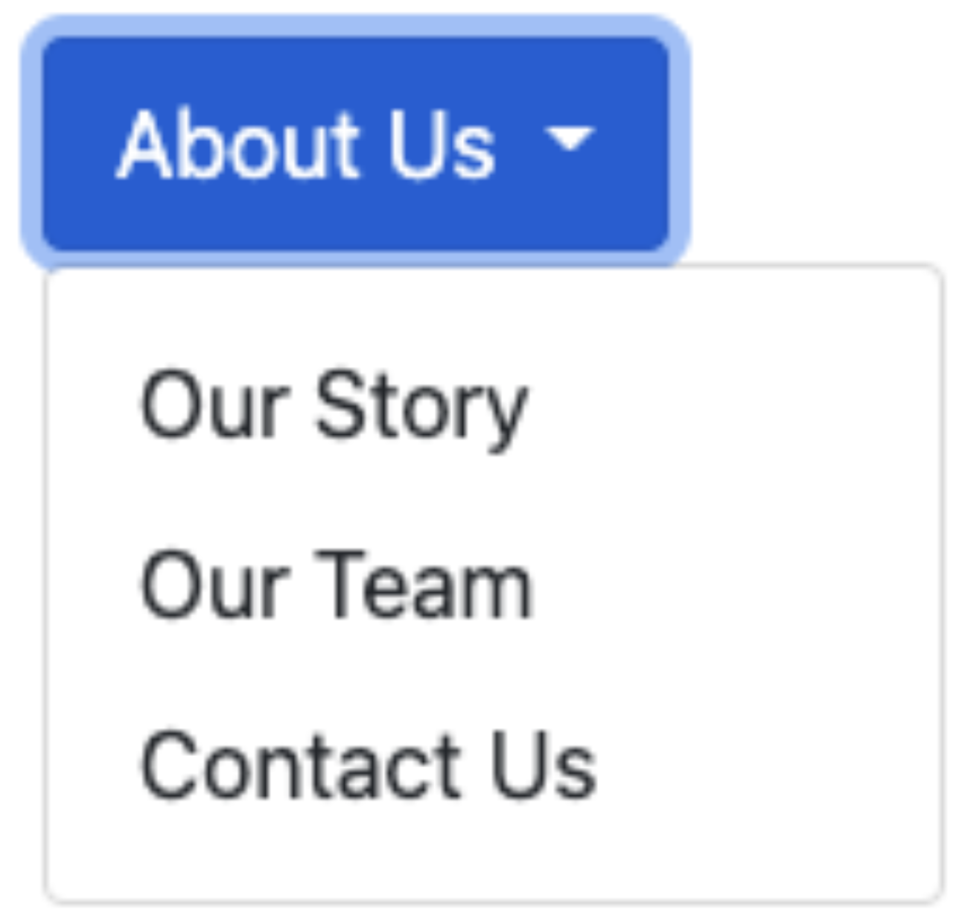
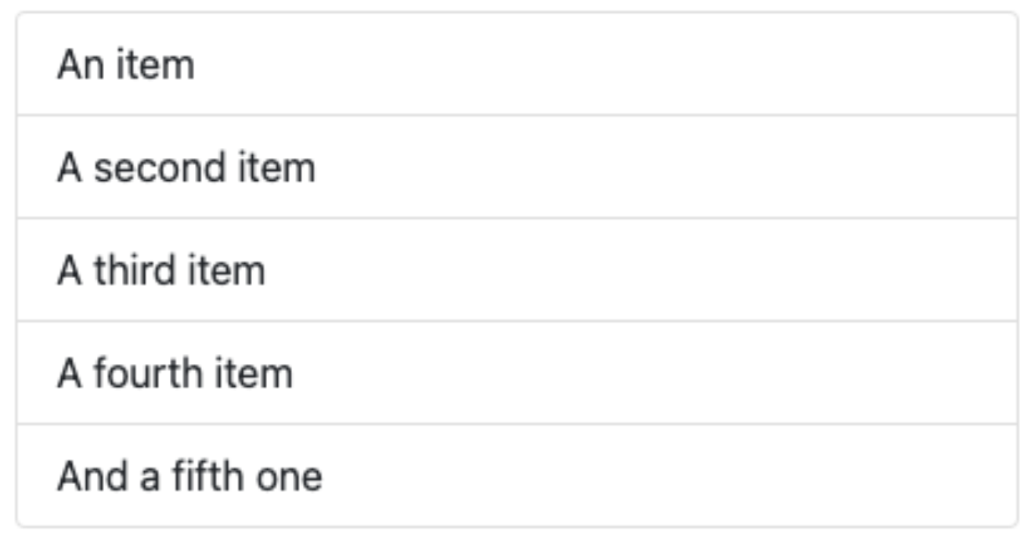
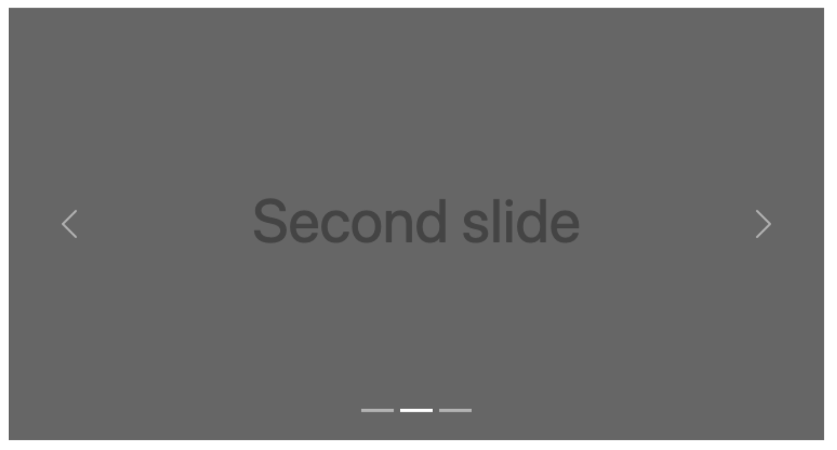
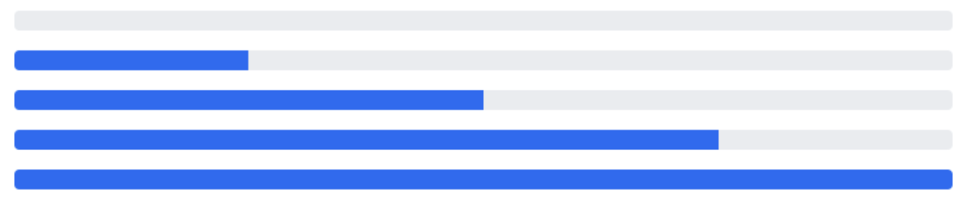
Bootstrap Components
Button Component
Button Group
Cards
Dropdowns
List Group
Progress bar
Navbar
Slider

Slide 13
Thanks and Happy coding!

